Slide 1


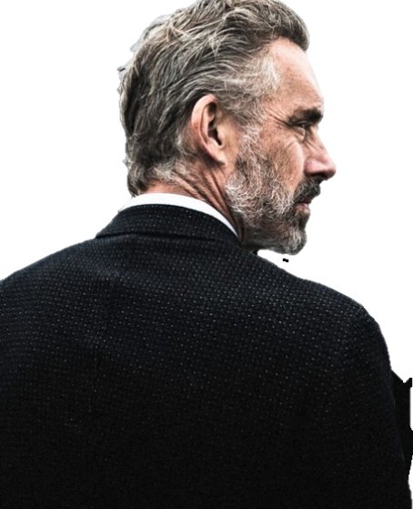


Made by Noah Lee 32193430@dankook.ac.kr

Slide 2
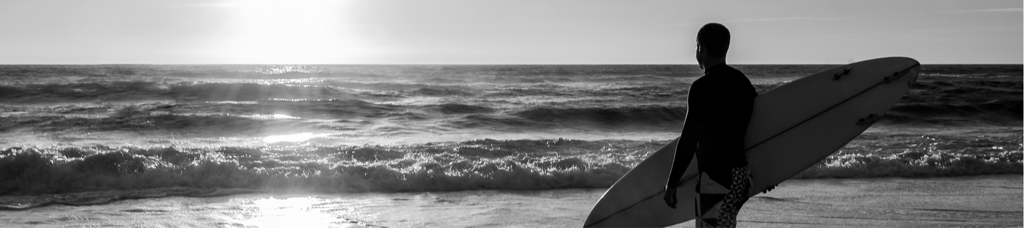




Slide 3




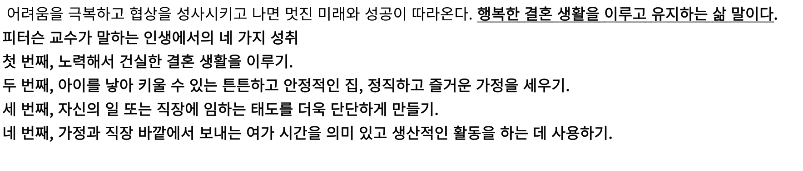




Slide 4

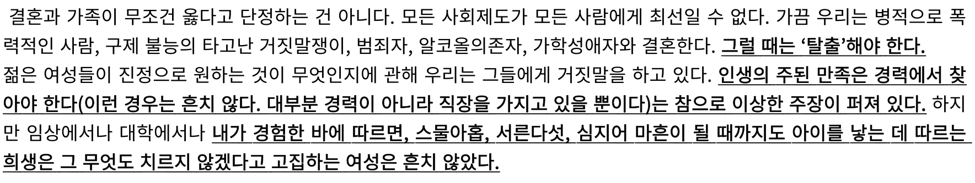



Slide 5

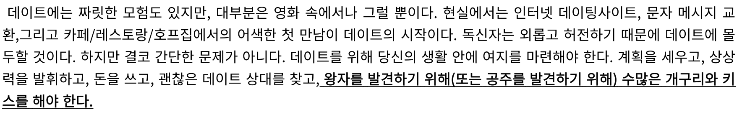
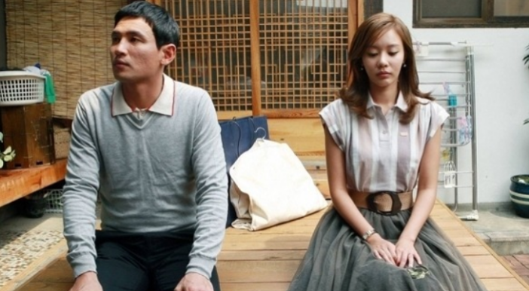


Slide 6

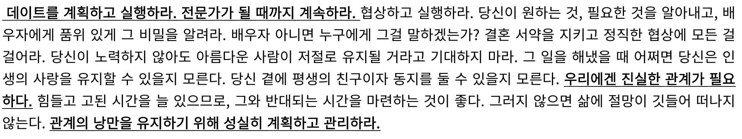



Slide 7

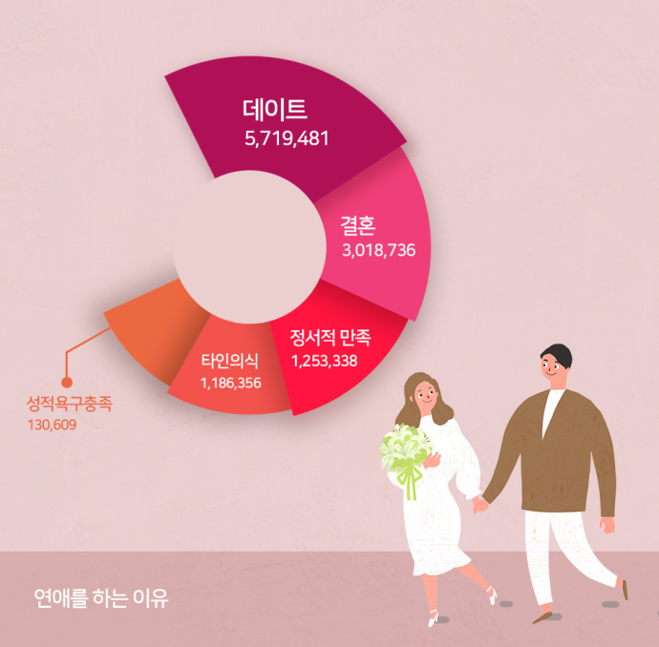

Slide 8


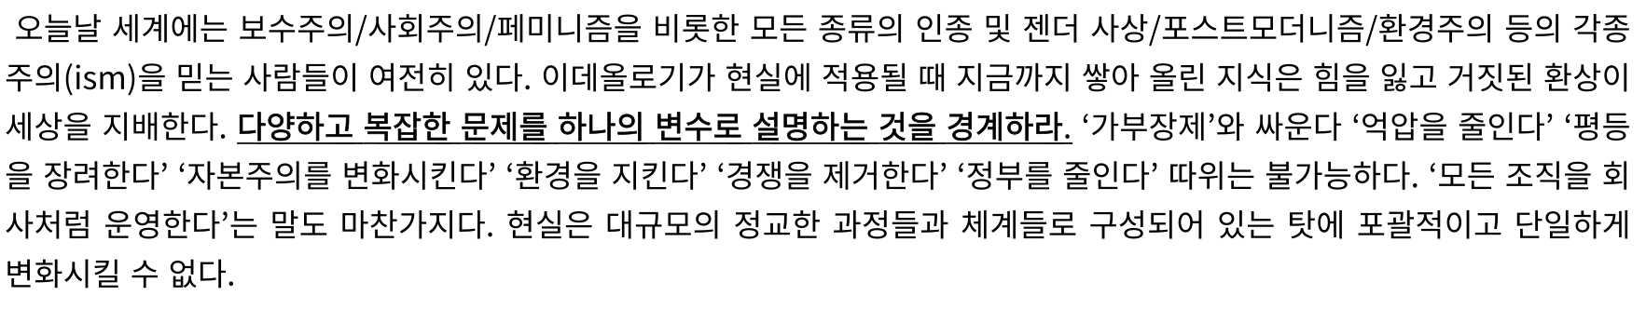






Slide 9

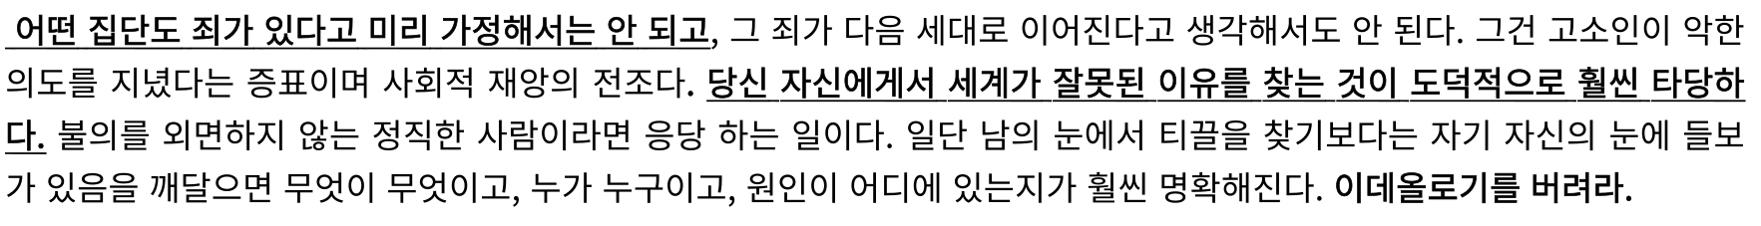

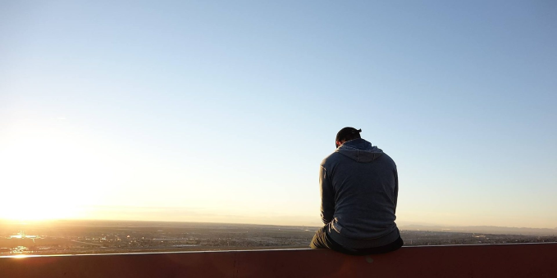

Slide 10



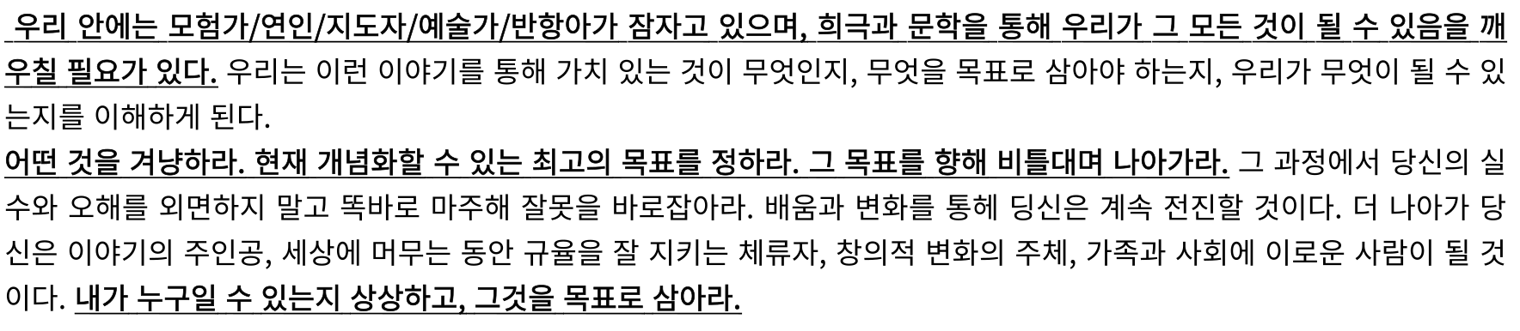



Slide 11


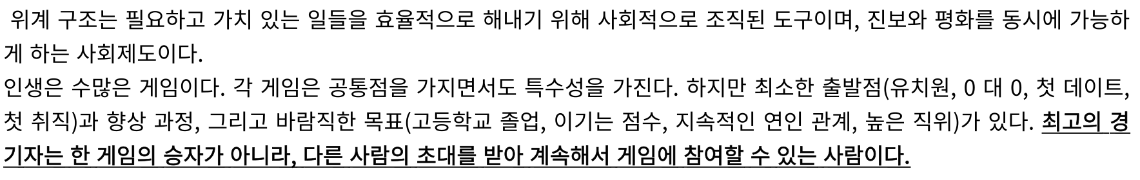



Slide 12

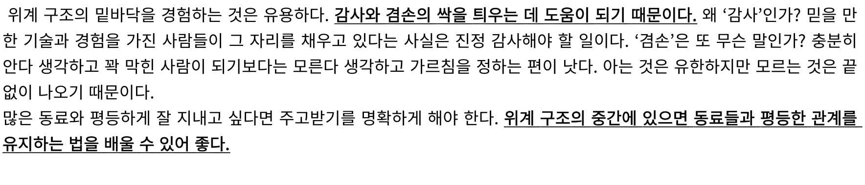


Slide 13


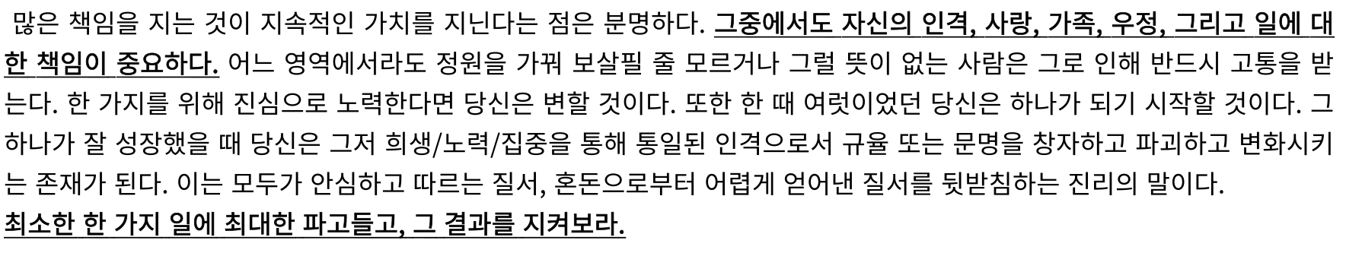


Slide 14
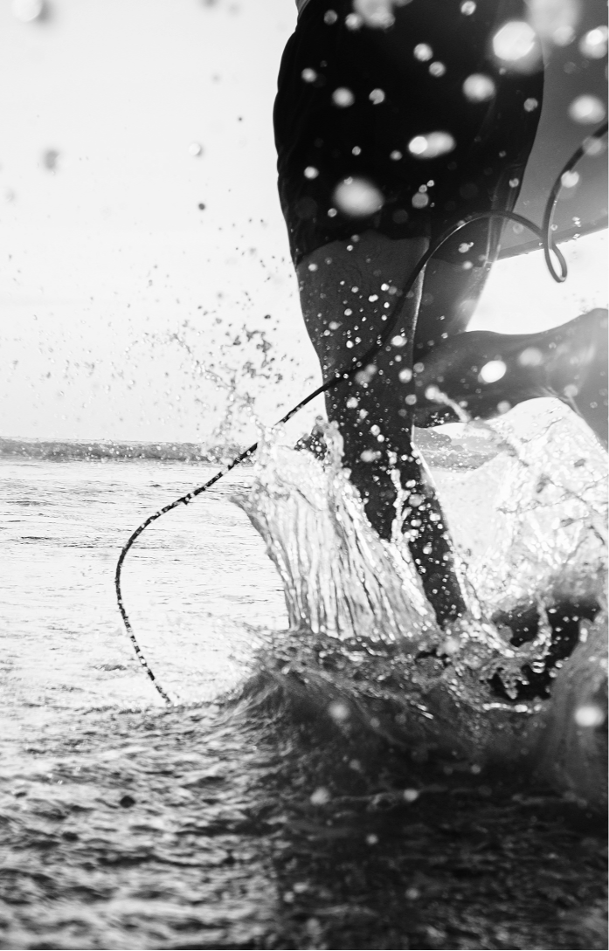

이미지 출처
https://www.simplemost.com/wp-content/uploads/2018/09/AdobeStock_164301870-e1543500880108.jpeg
https://www.simplemost.com/wp-content/uploads/2018/09/AdobeStock_164301870-e1543500880108.jpeg
https://t1.daumcdn.net/cfile/tistory/997A26335C8F963101
https://www.ipsos.com/en/bbc-global-survey-world-divided
https://www.ipsos.com/en/bbc-global-survey-world-divided

Slide 15




